Slide 1
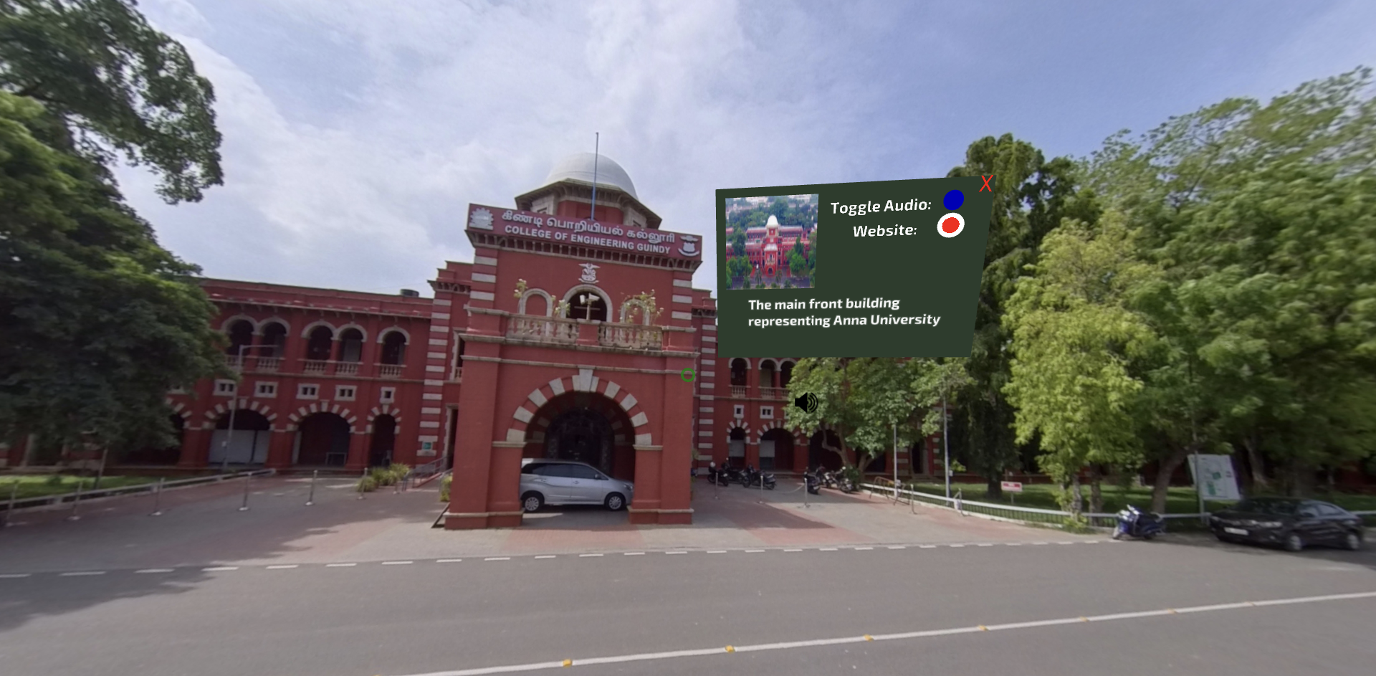
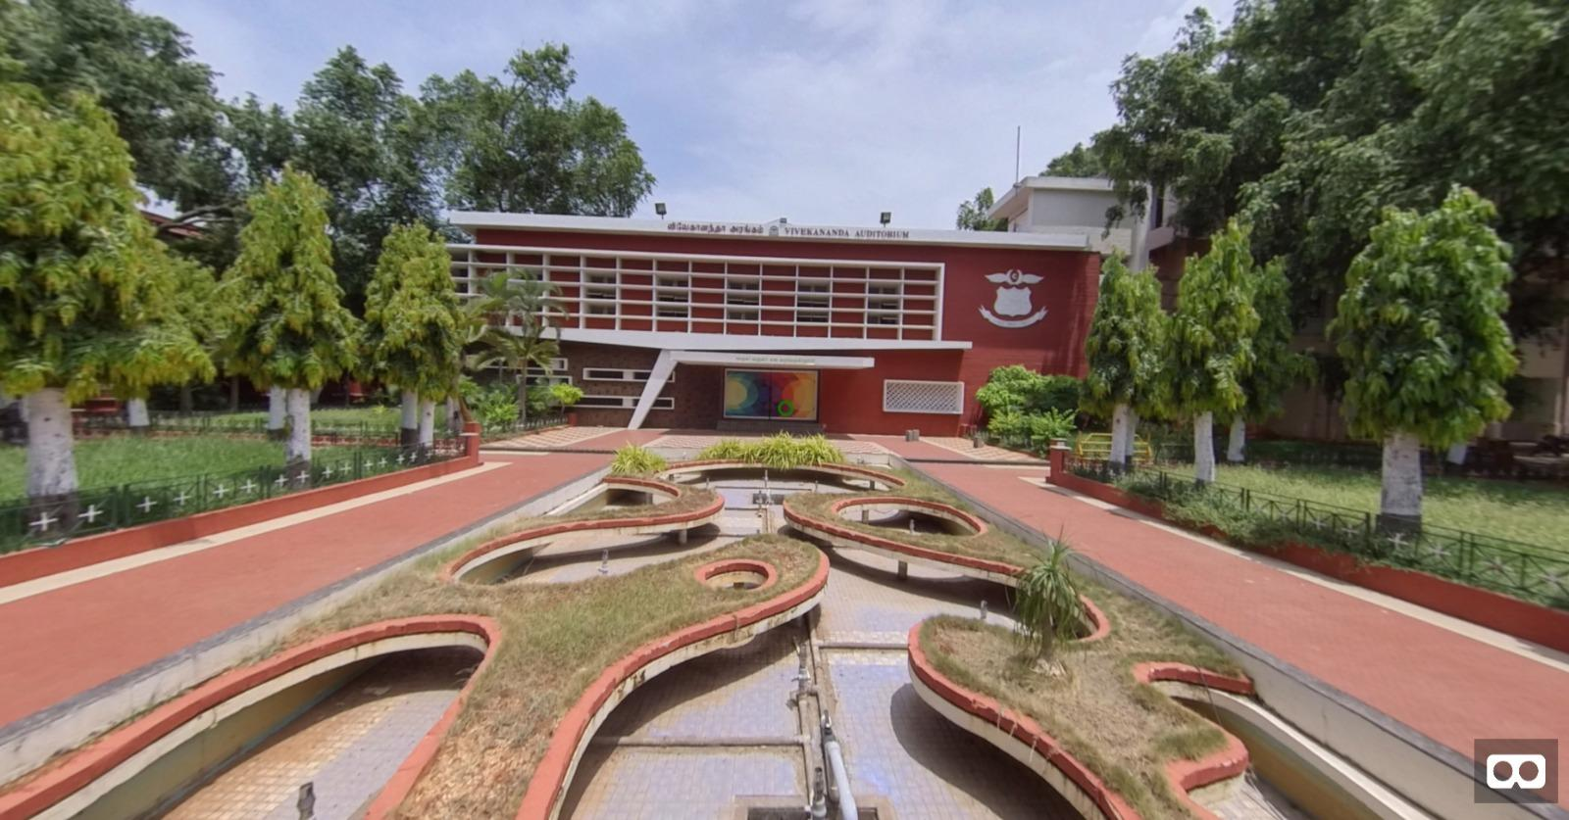
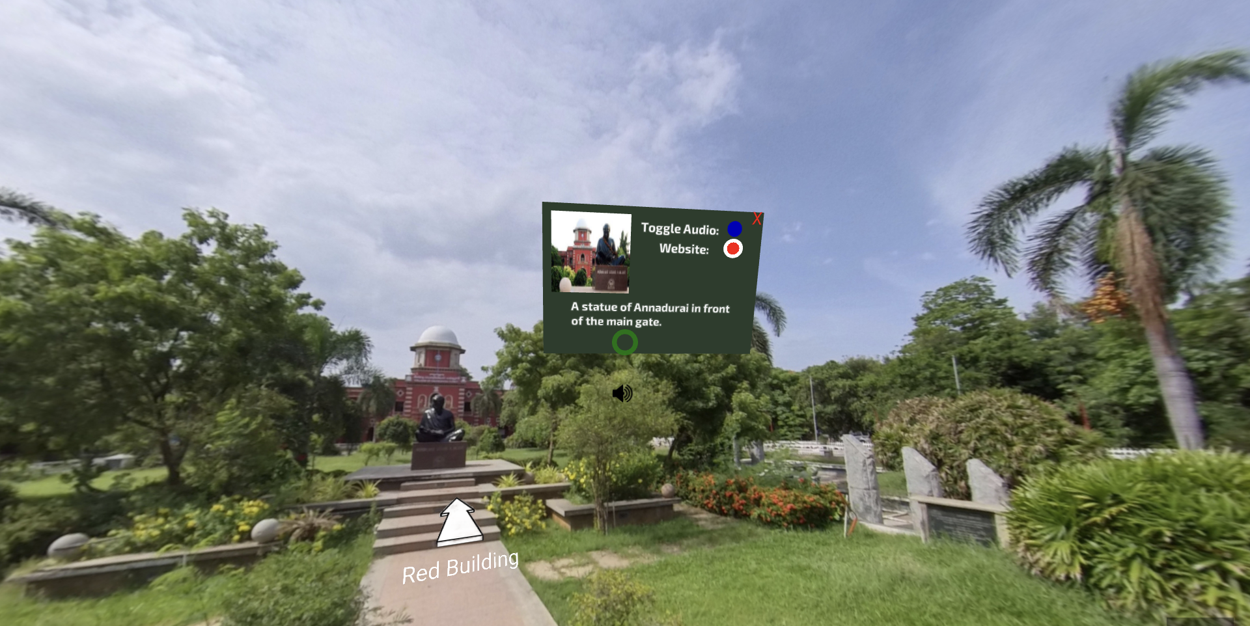
360 Virtual Tour
Provides an immersive tour of CEG campus - Anna University, with detailed information about each place.
Enhances the user experience with the use of text-to speech and soothing background music.
Guide: Dr. S. Chitrakala, Professor- DCSE, Director - CIT, CEG, Anna University
Co-Guide: Ms. M. S. Karthika Devi, Deputy Director - CIT, Asst. Professor – DCSE, CEG, Anna University
Industry Mentor: Mr. Senthamizh, XR Consultant, The DreamX, Chennai
Team Members:
Srihari S., UG 2021-2025, DME CEG, Anna University, Chennai
Rushil A Krishnan, UG 2021-2025, DCSE CEG, Anna University

